Slide 1

Final Year Project

Slide 2

Group Leader :- Rohitraj Deshmukh
Team Members :- 1. Vishal Kothalkar (Roll N0: 81)
2. Akhil Jamatkar (Roll No: 34)
3. Monish Sathe (Roll No: 52)
4. Rohitraj Deshmukh (Roll No: 67)
Group Mentor :- Prof. Sagar Padiya (IT)

Slide 3
Contents
Title of the Project
Problem Definition
Objectives
Technology Stack
Flowchart
Project Execution

Slide 4

CITYSERVICES Android Application

Slide 5

Problem Definition
Now human life depends on lots of appliances and housekeeping. In the house, everyone has electric, electronic, mechanical, instrumental appliances, furniture, plumbing, etc. All these home appliances and other products required regular maintenance. The finding of proper human resources for maintenance is a big challenge.
To encounter such problem, CITYSERVICES Application comes to the picture.
All-in-one platform that will help the users hire premium service professional, from beauticians and masseurs to sofa cleaners, carpenters and technicians.
A platform to allow skilled and experienced professional to connect with users looking for specific services.

Slide 6
Objectives
Develop CITYSERVICES Android Application for the USER.
Aggregation of service provider (housekeepers, electrician, Beautician, etc) details at one place.
Book professional for services, conformation mail, etc
Review and Rating of service providers by customers.
Advertisement of Services (For the generation of revenue)

Slide 7
Technology Stack
ReactNative
Nodejs
Express
(API's)
Styled Components
Firebase

Slide 8
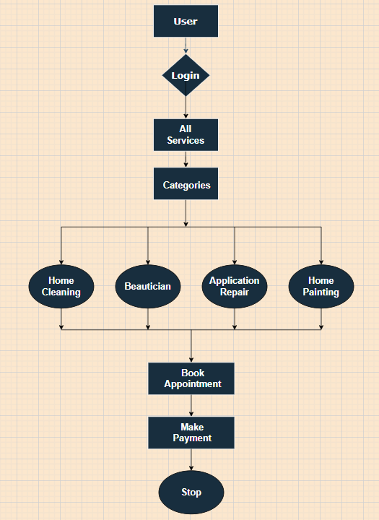
Flowchart

Slide 9
Project Execution

Slide 10
City Services User App

Slide 11
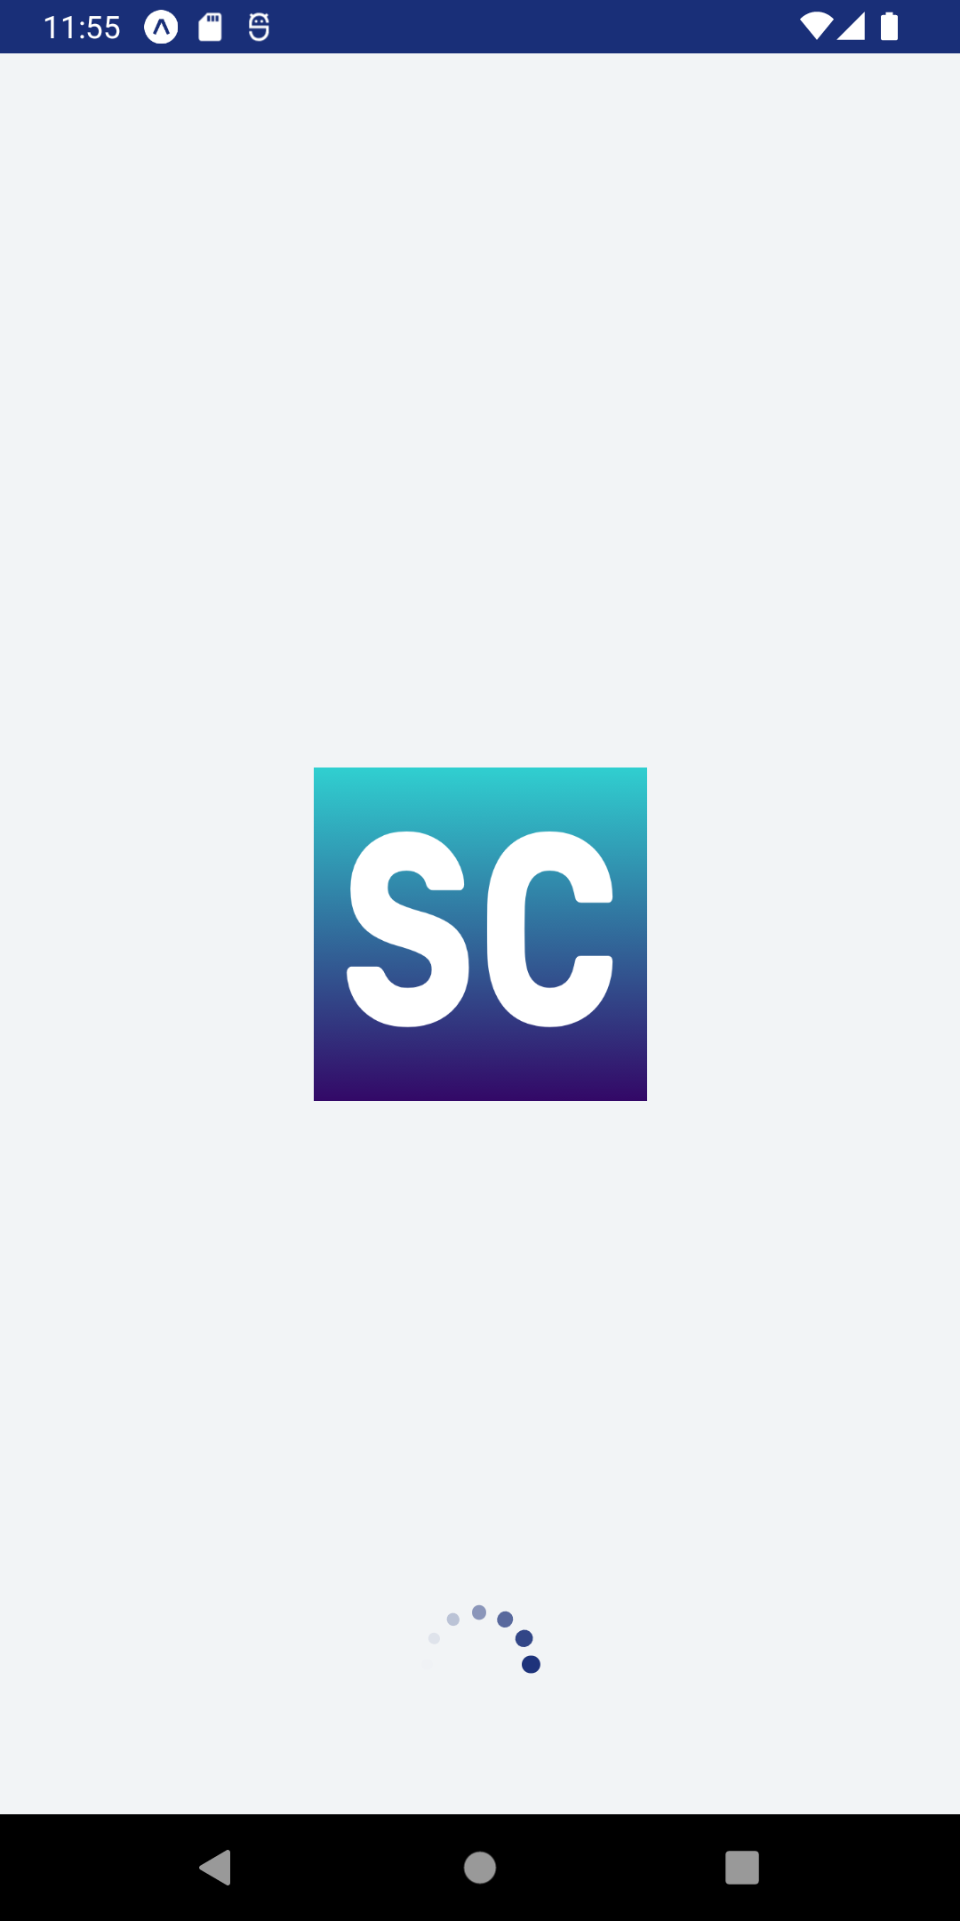
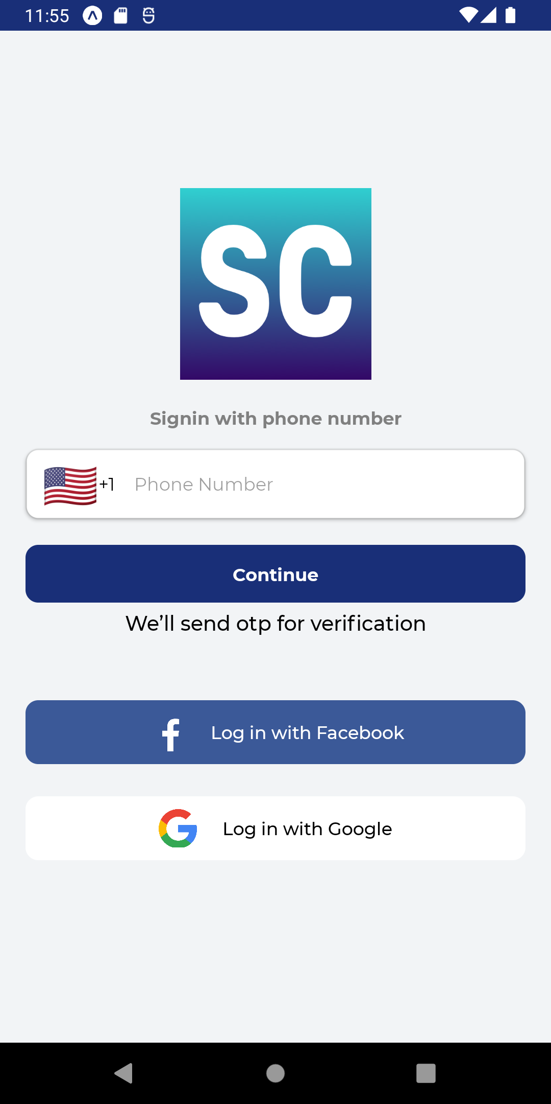
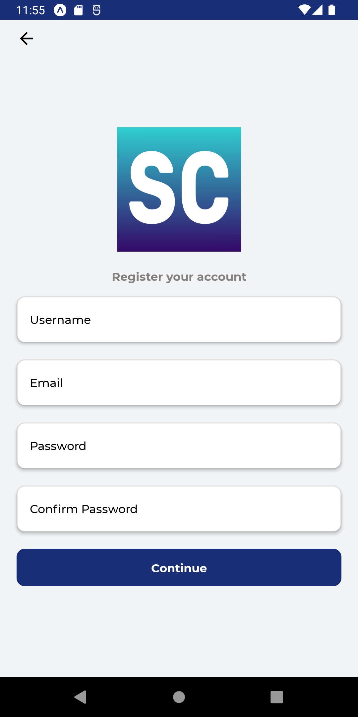
Splash Screen
Sign In Screen
Register Screen

Slide 12
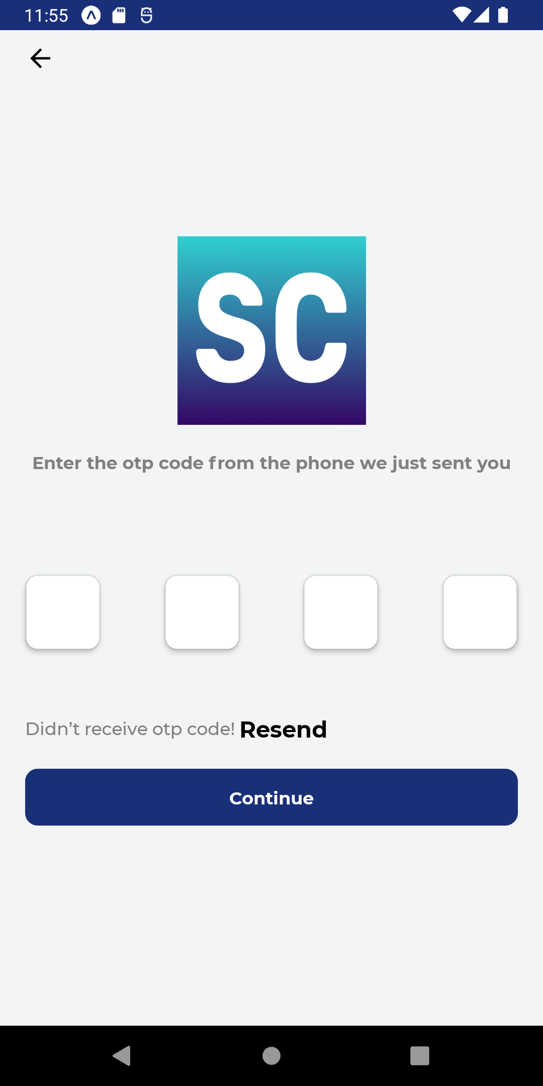
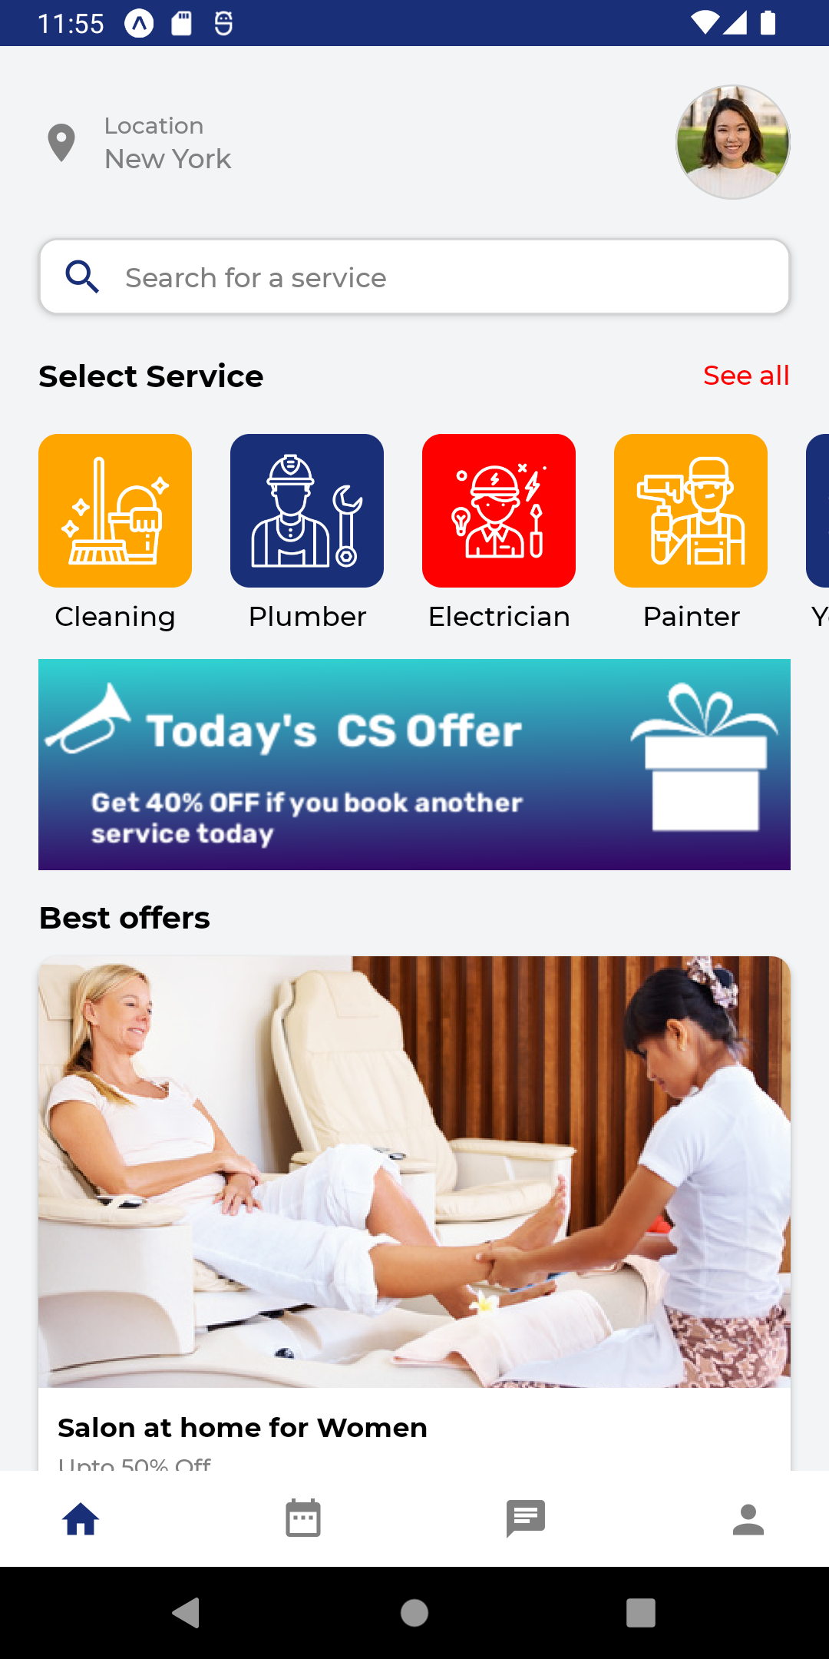
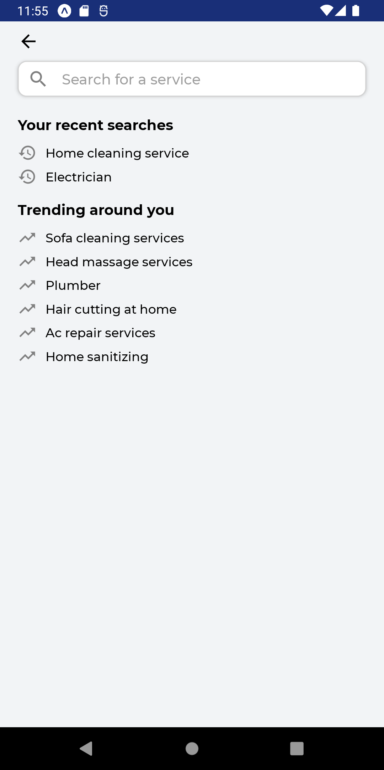

Slide 13
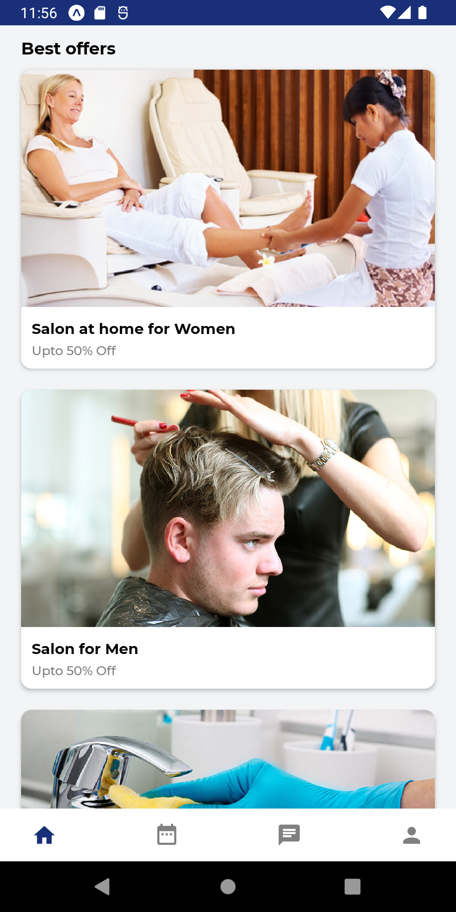
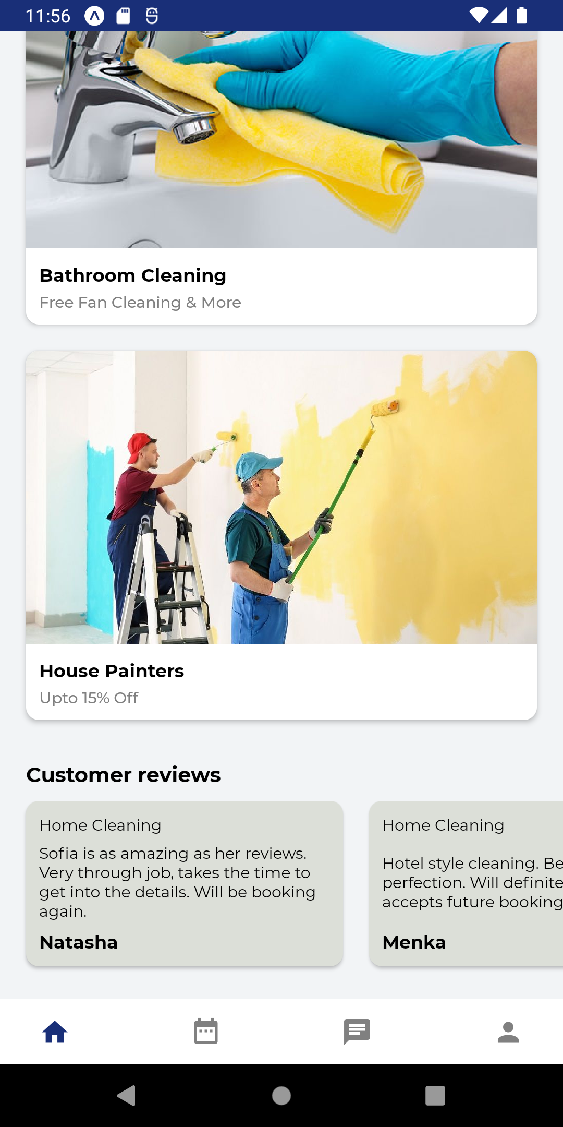
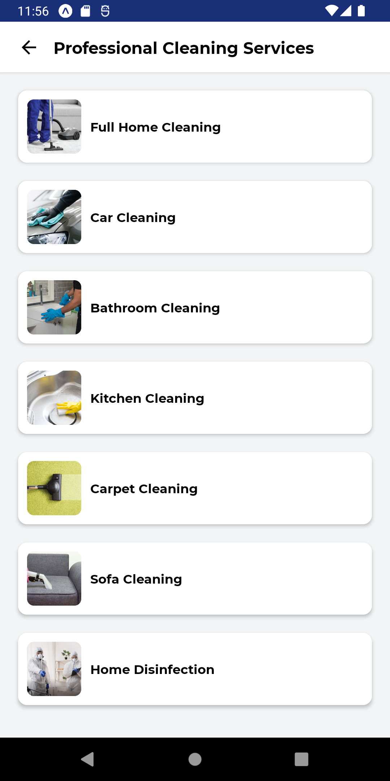

Slide 14
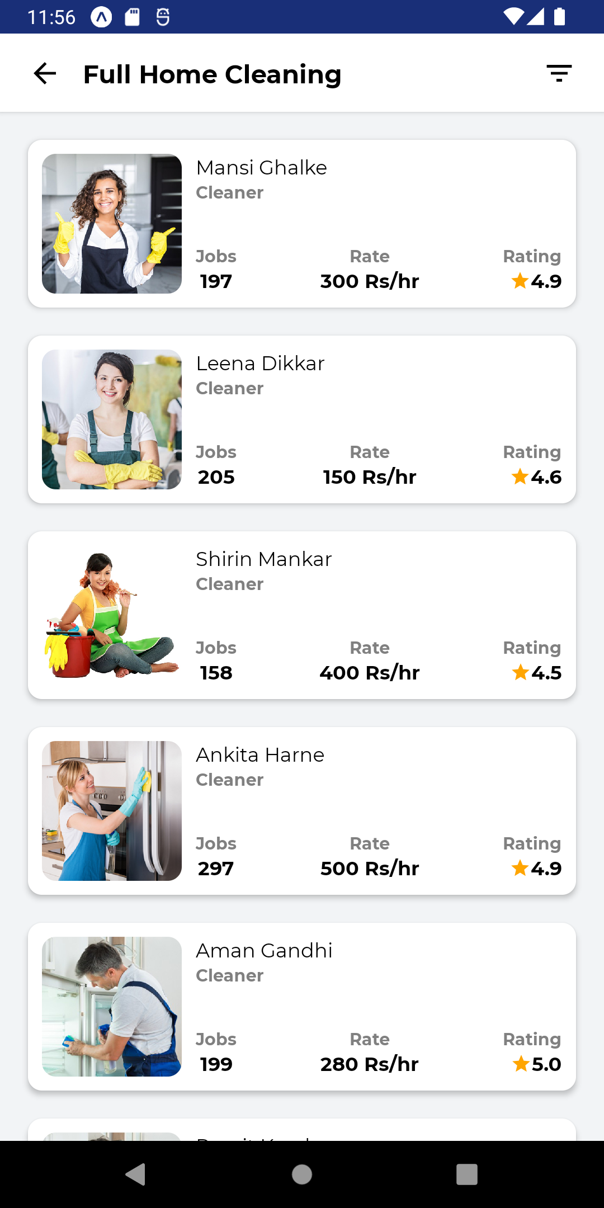
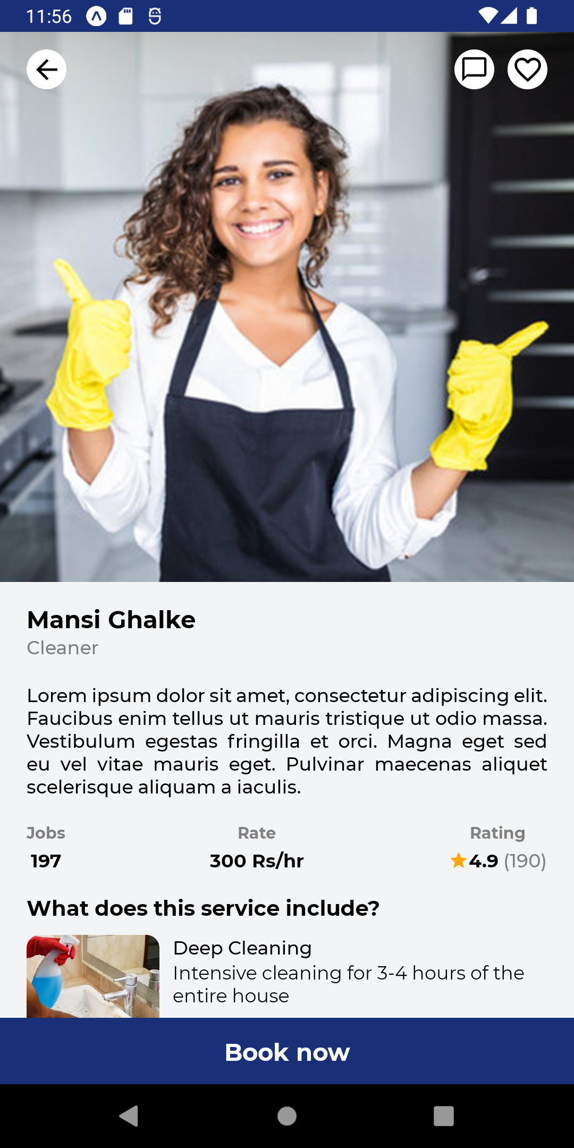
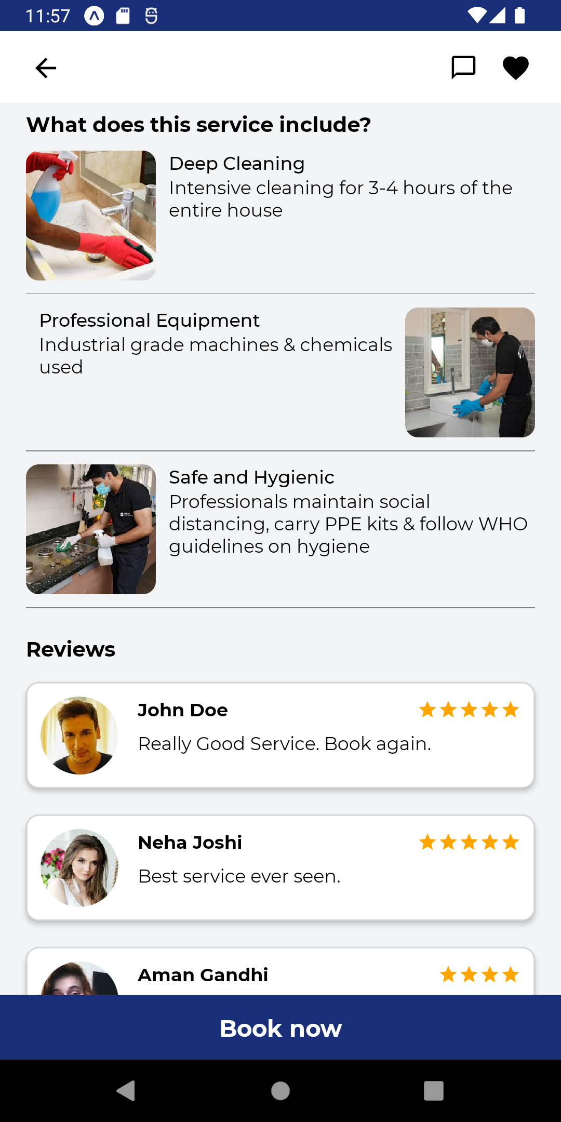

Slide 15
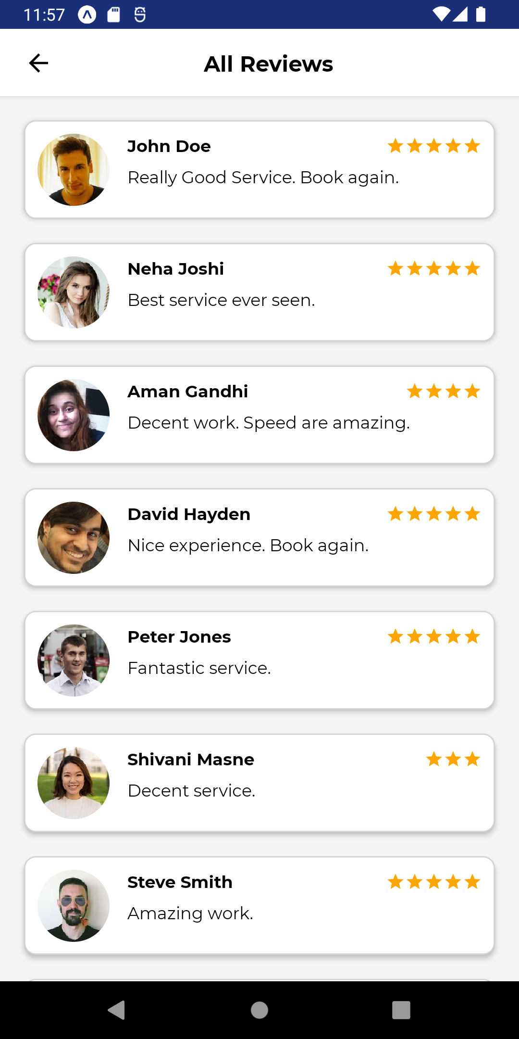
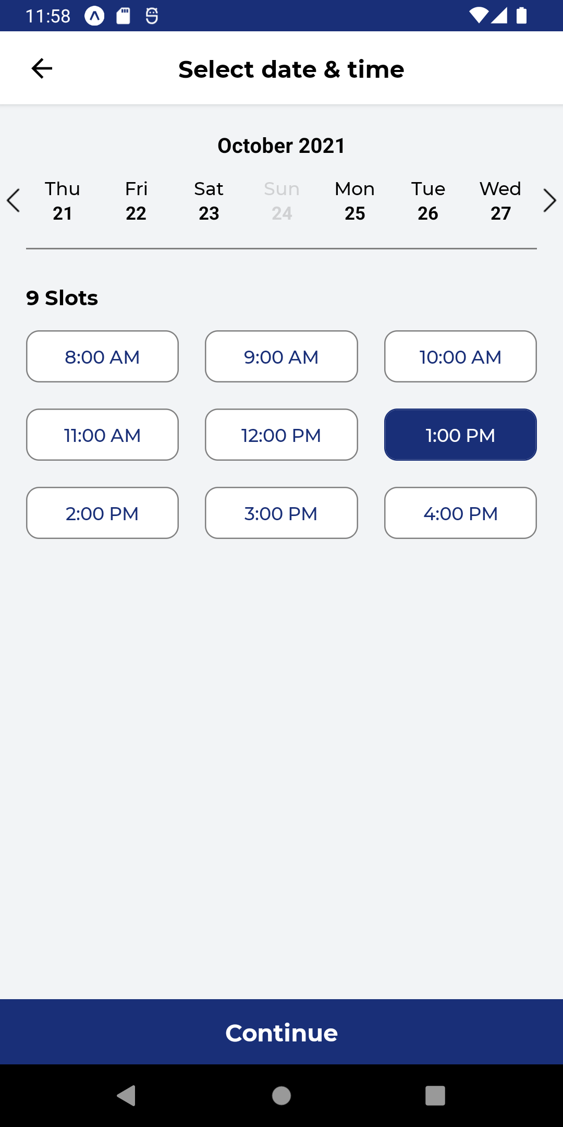
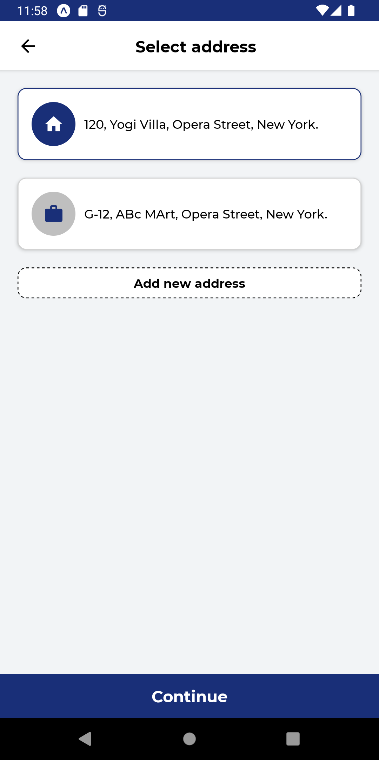

Slide 16
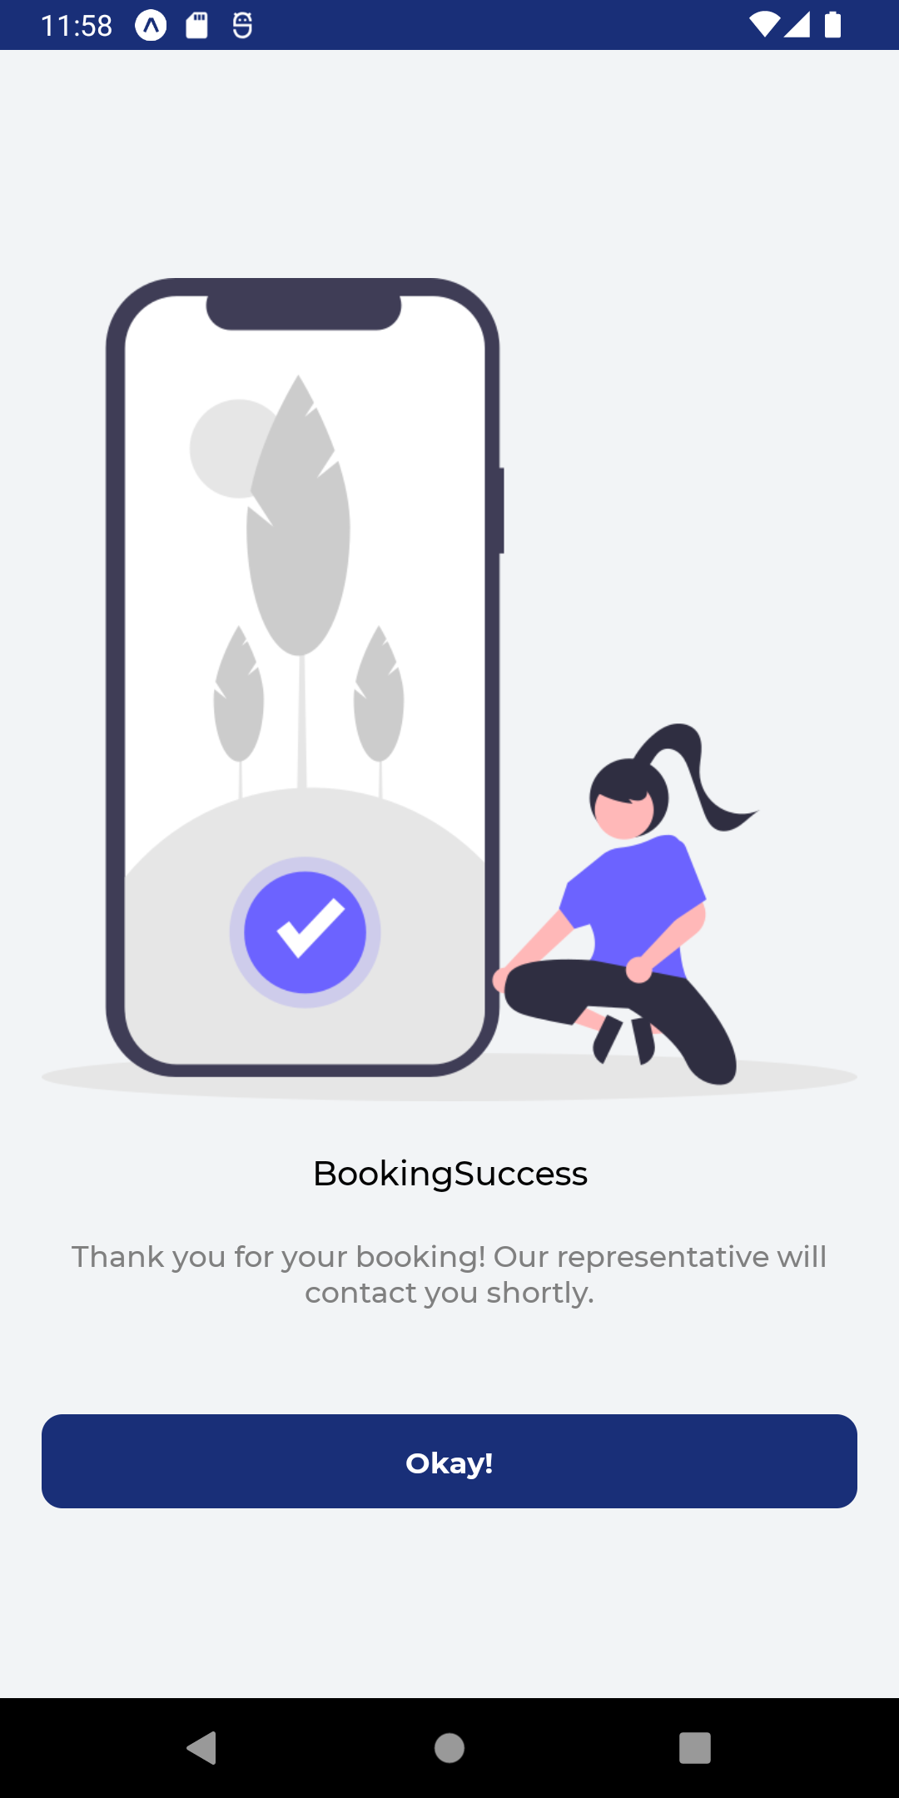
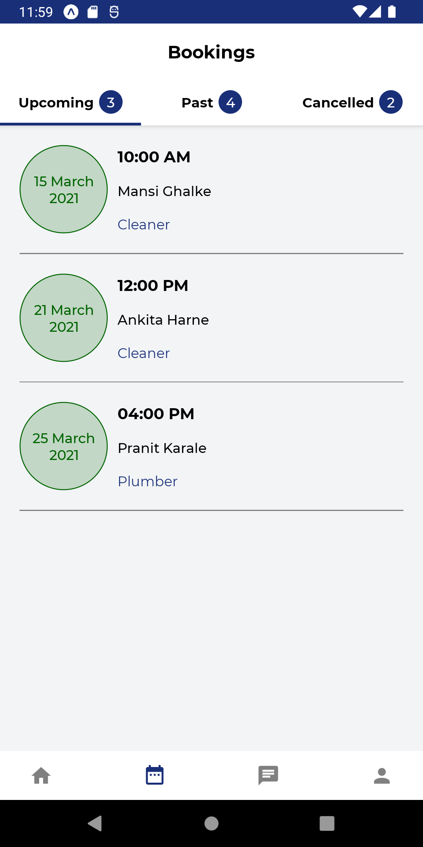
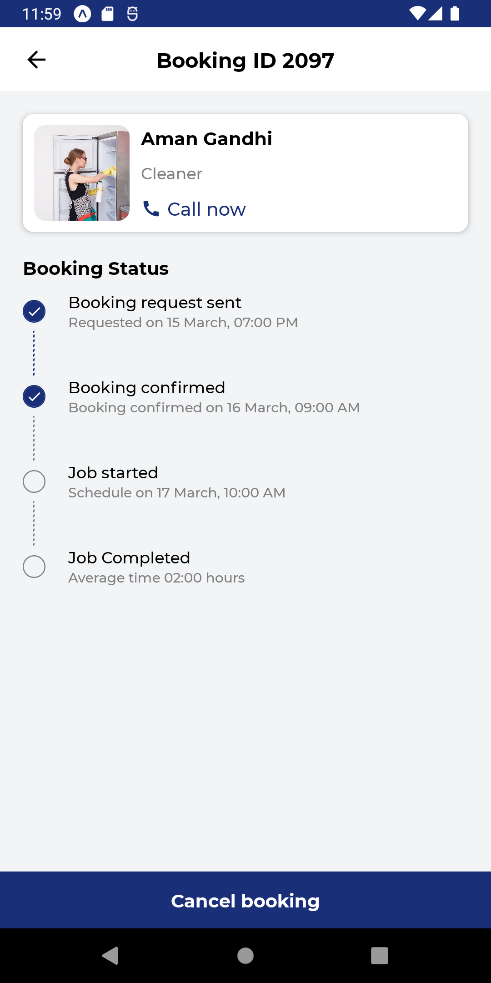

Slide 17
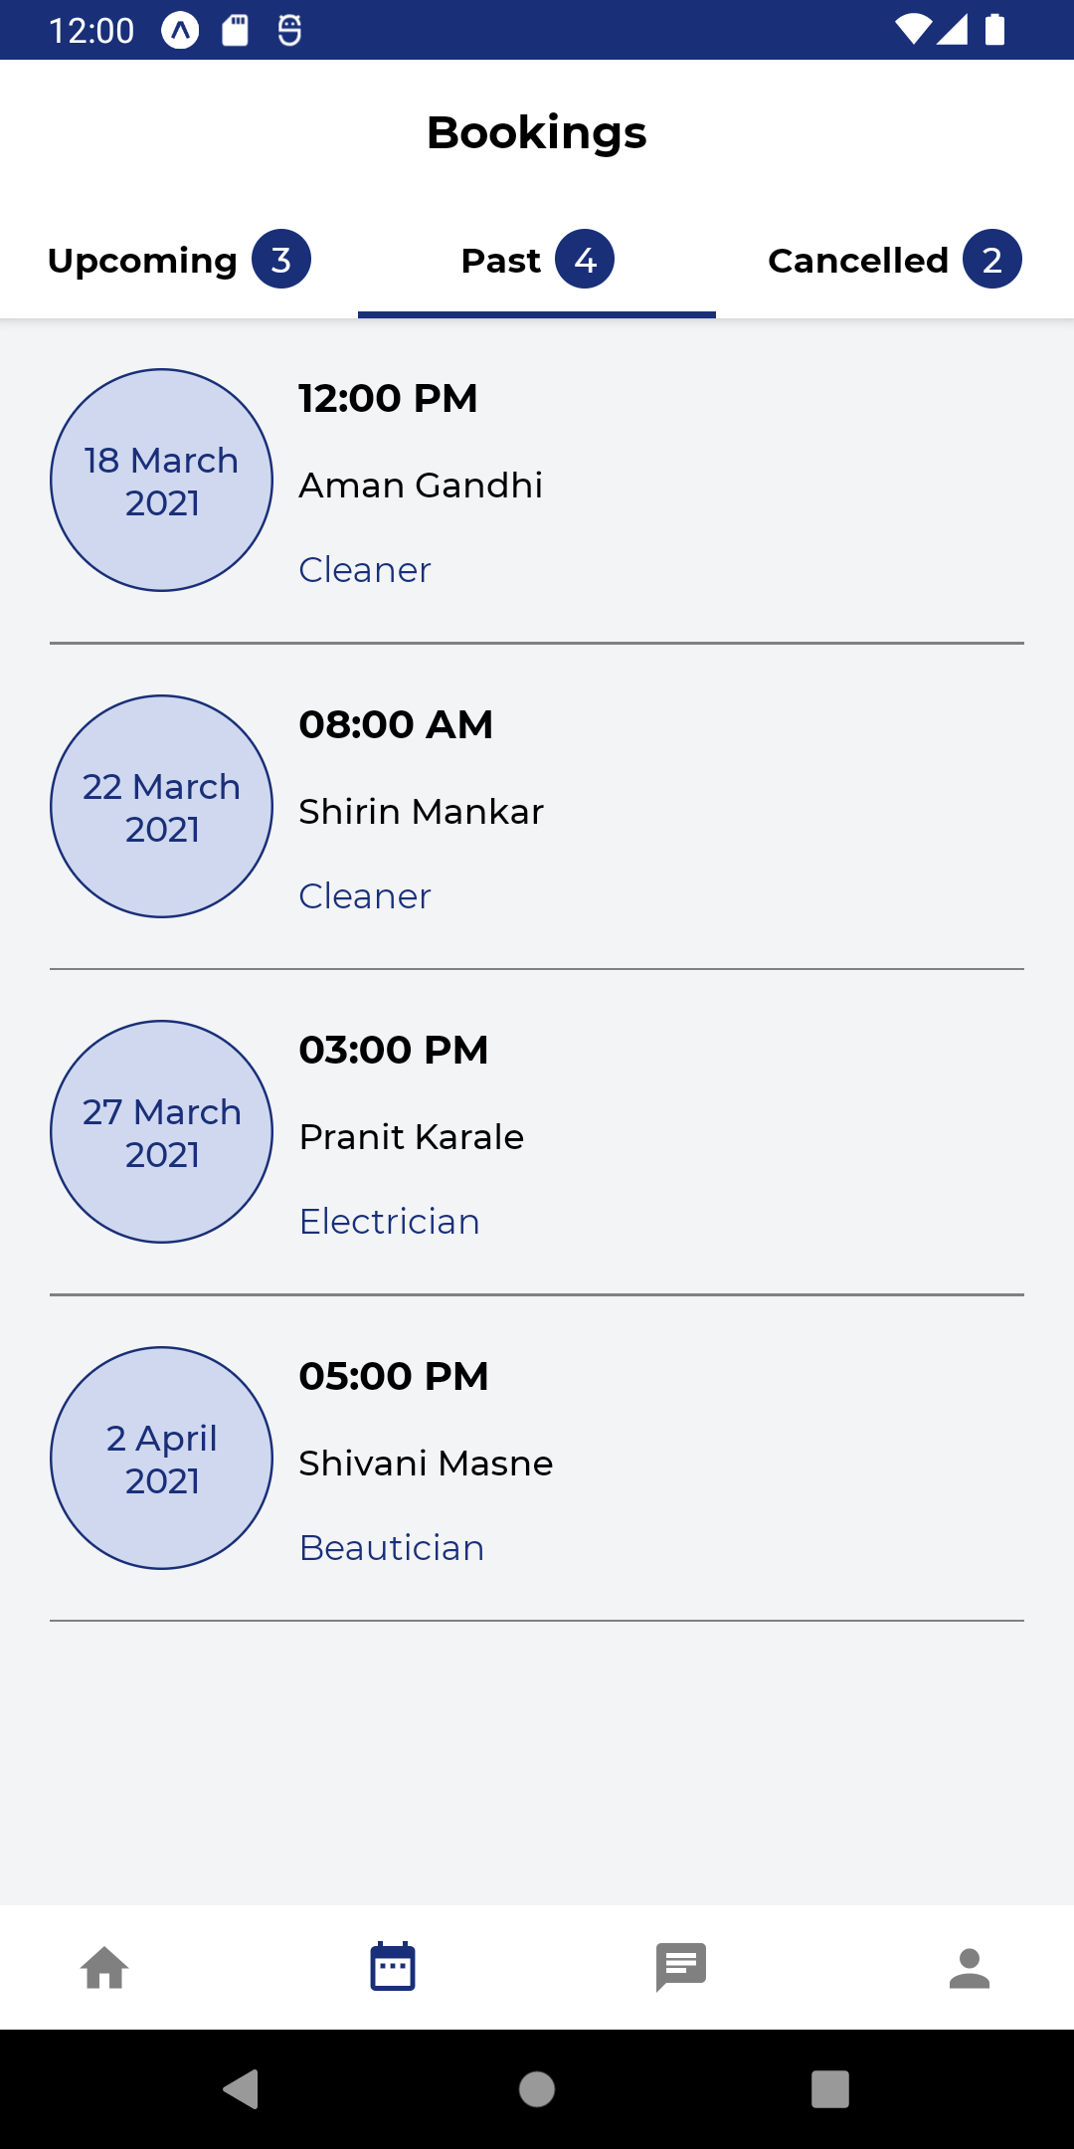
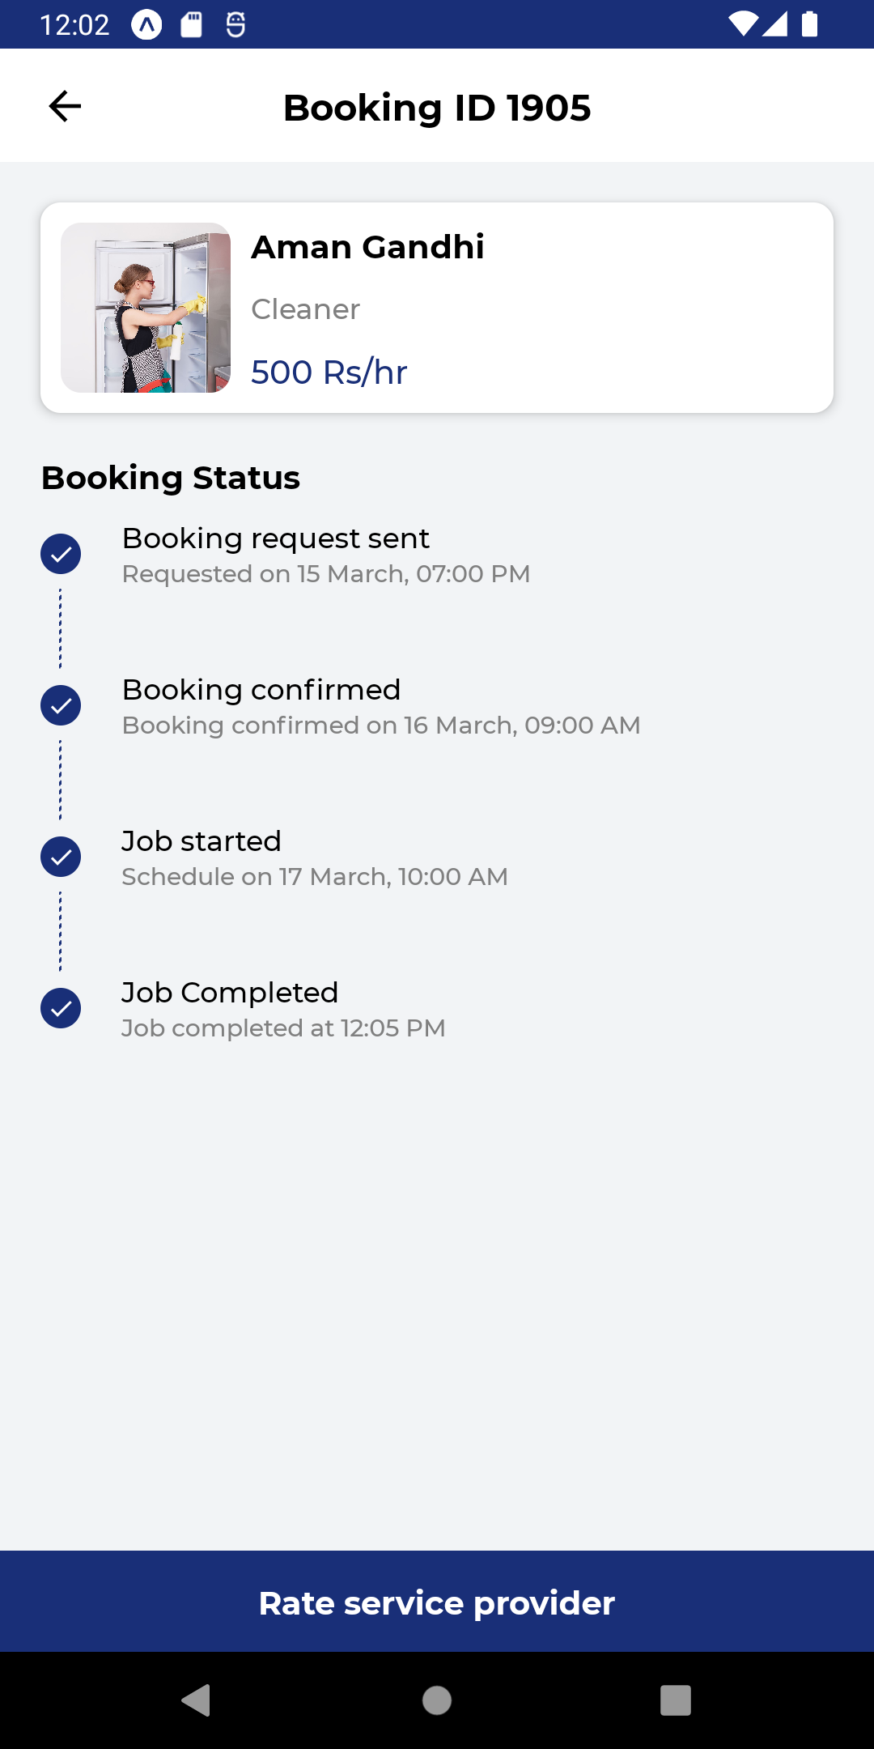
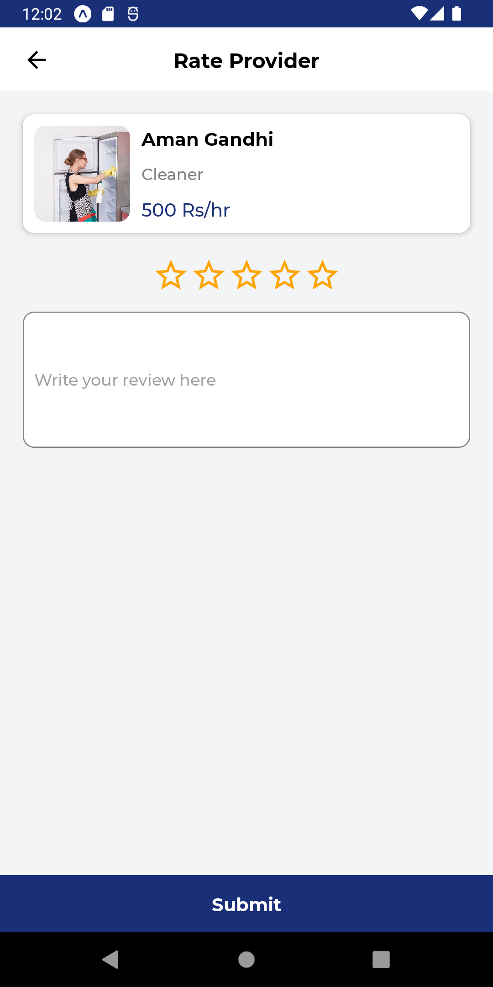

Slide 18
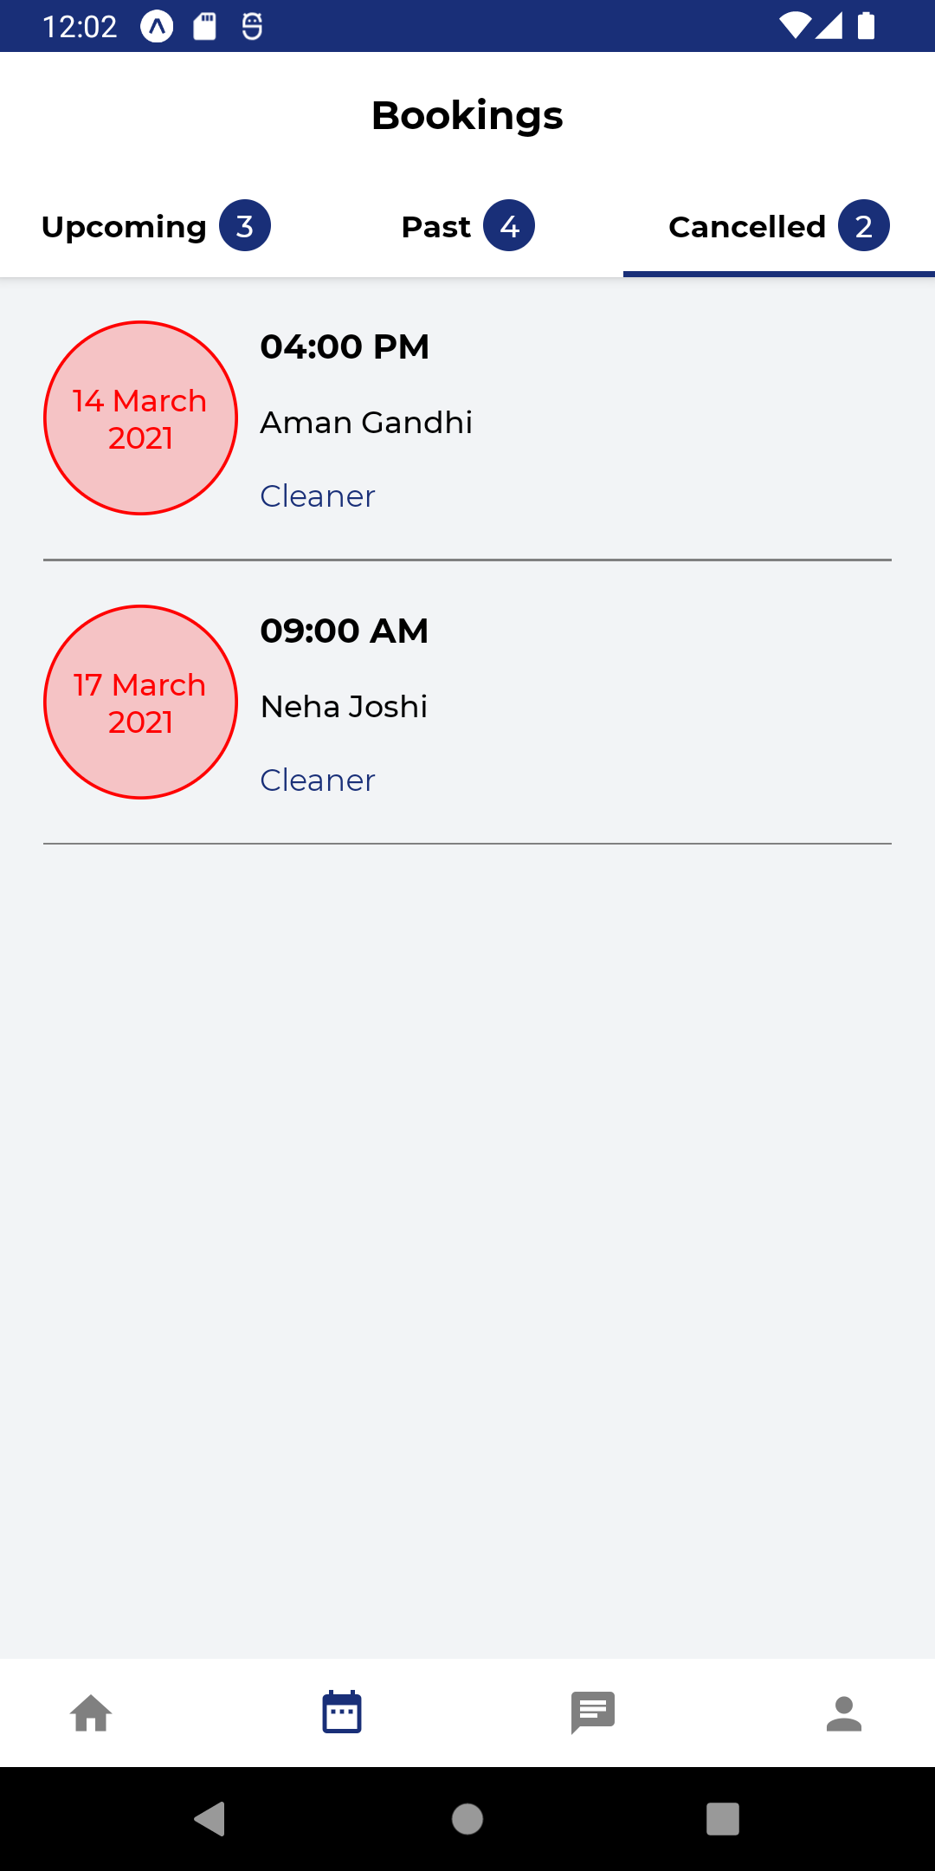
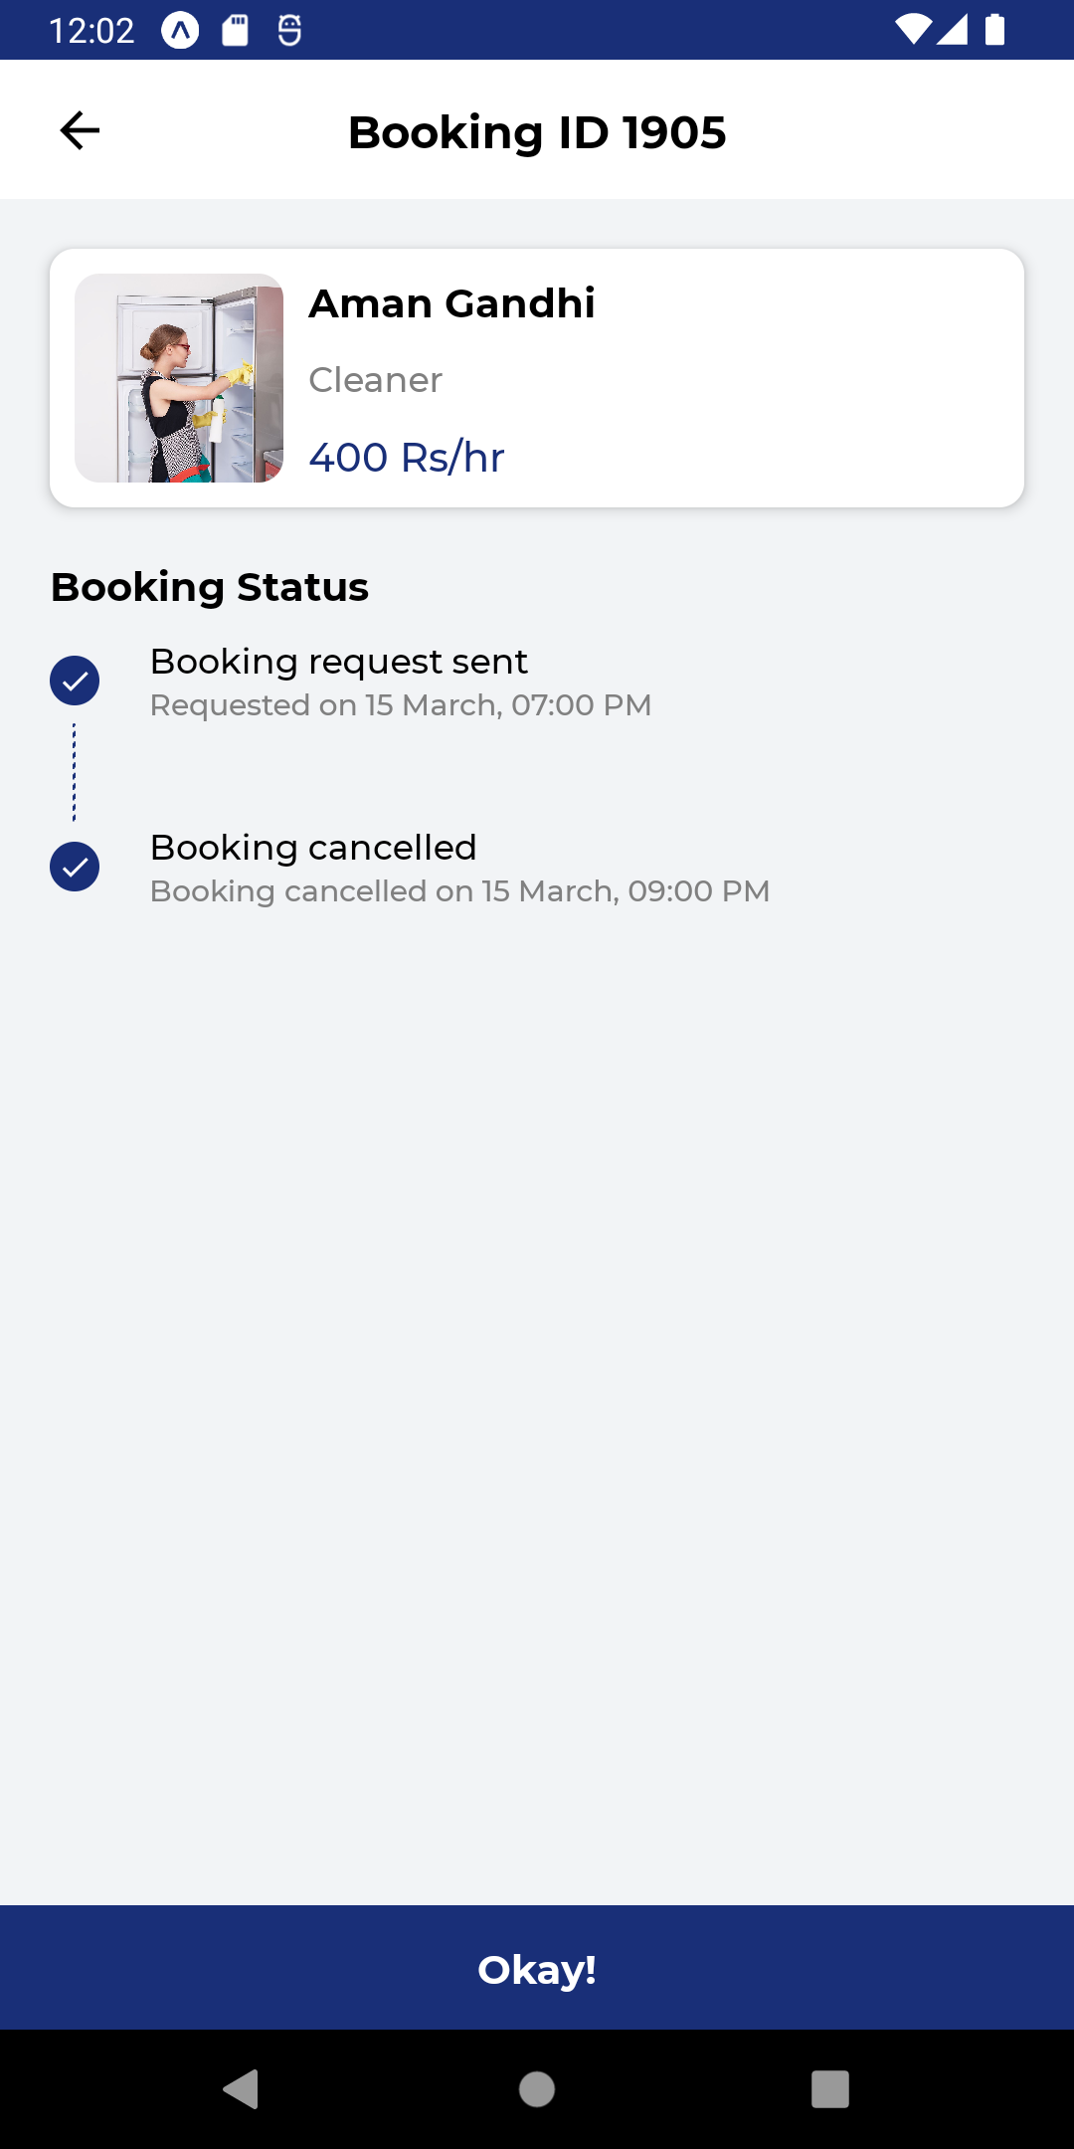
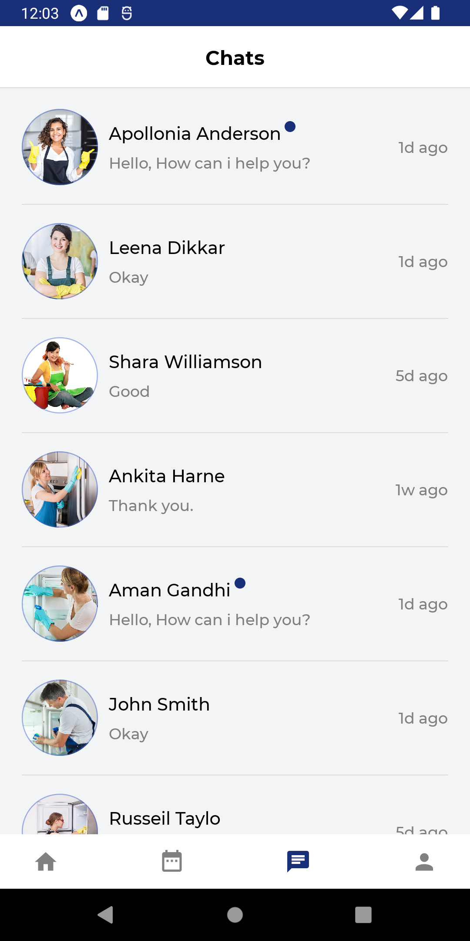

Slide 19
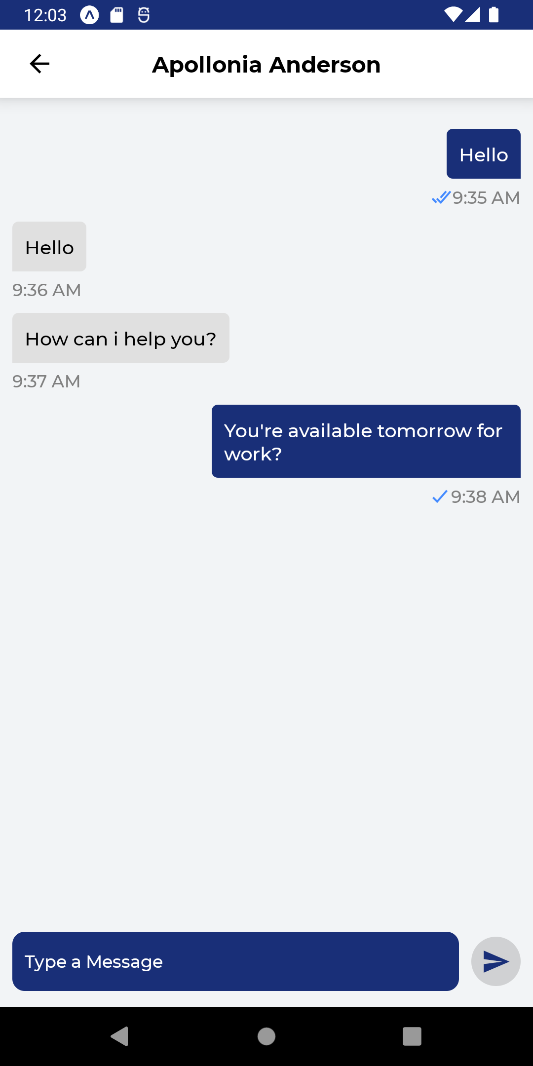
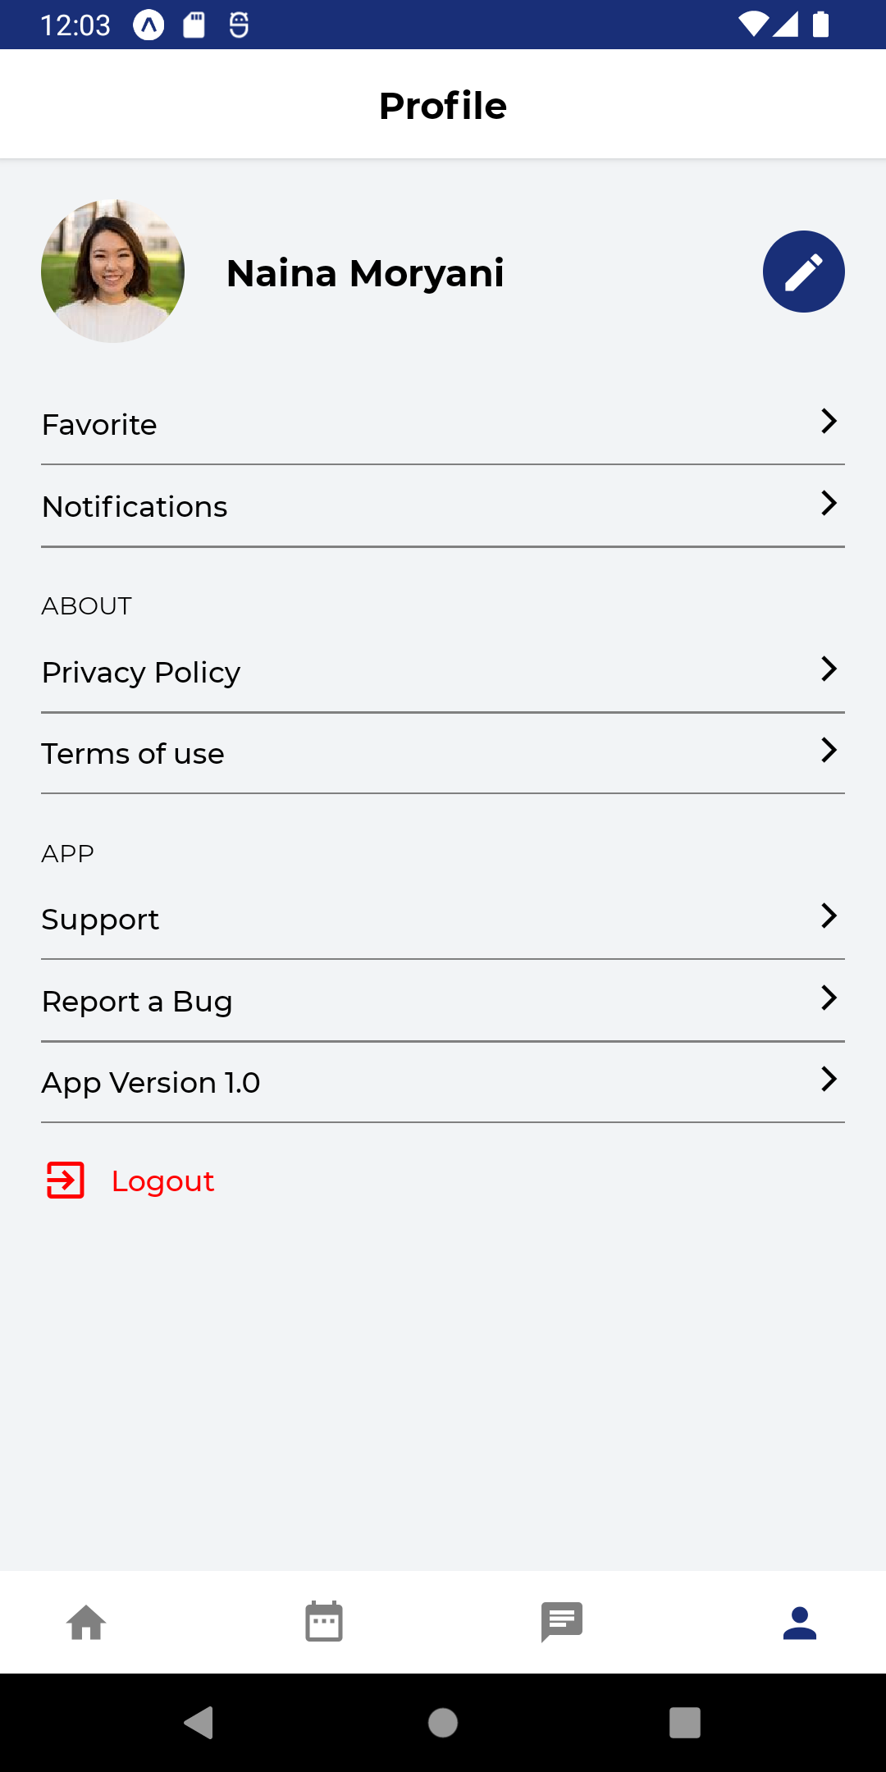
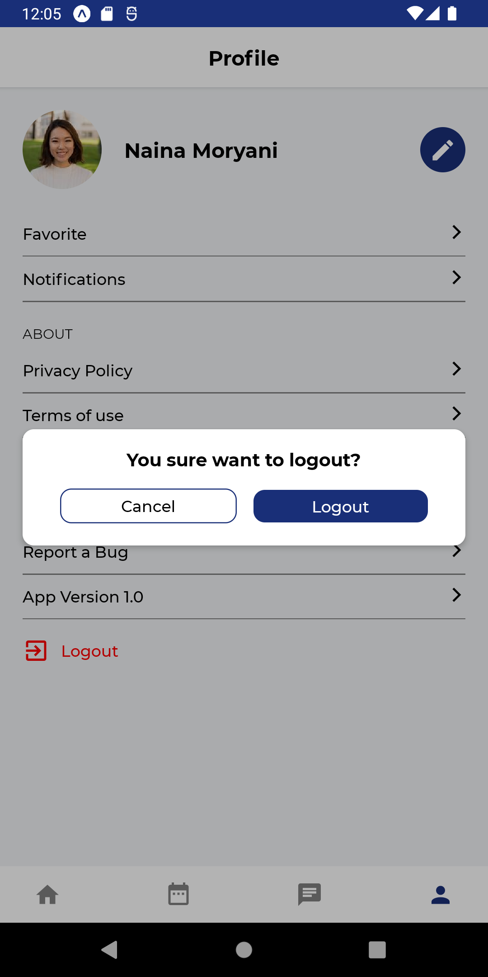

Slide 20
City Services Provider App

Slide 21
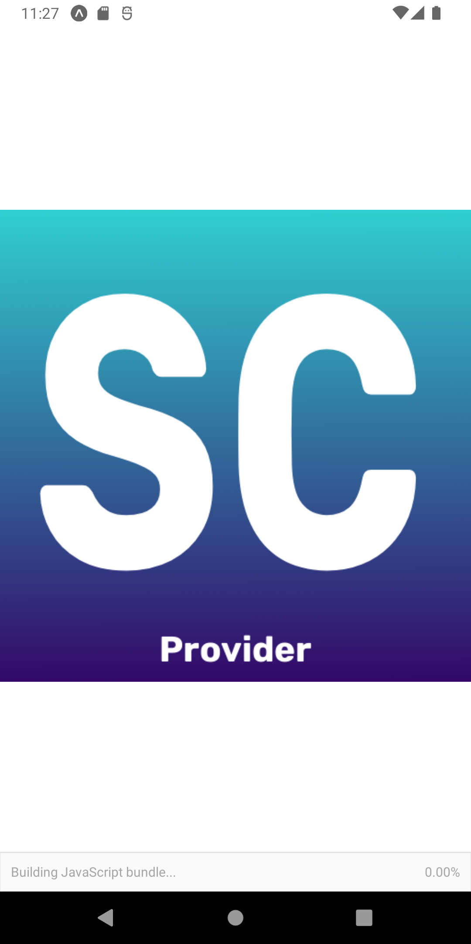
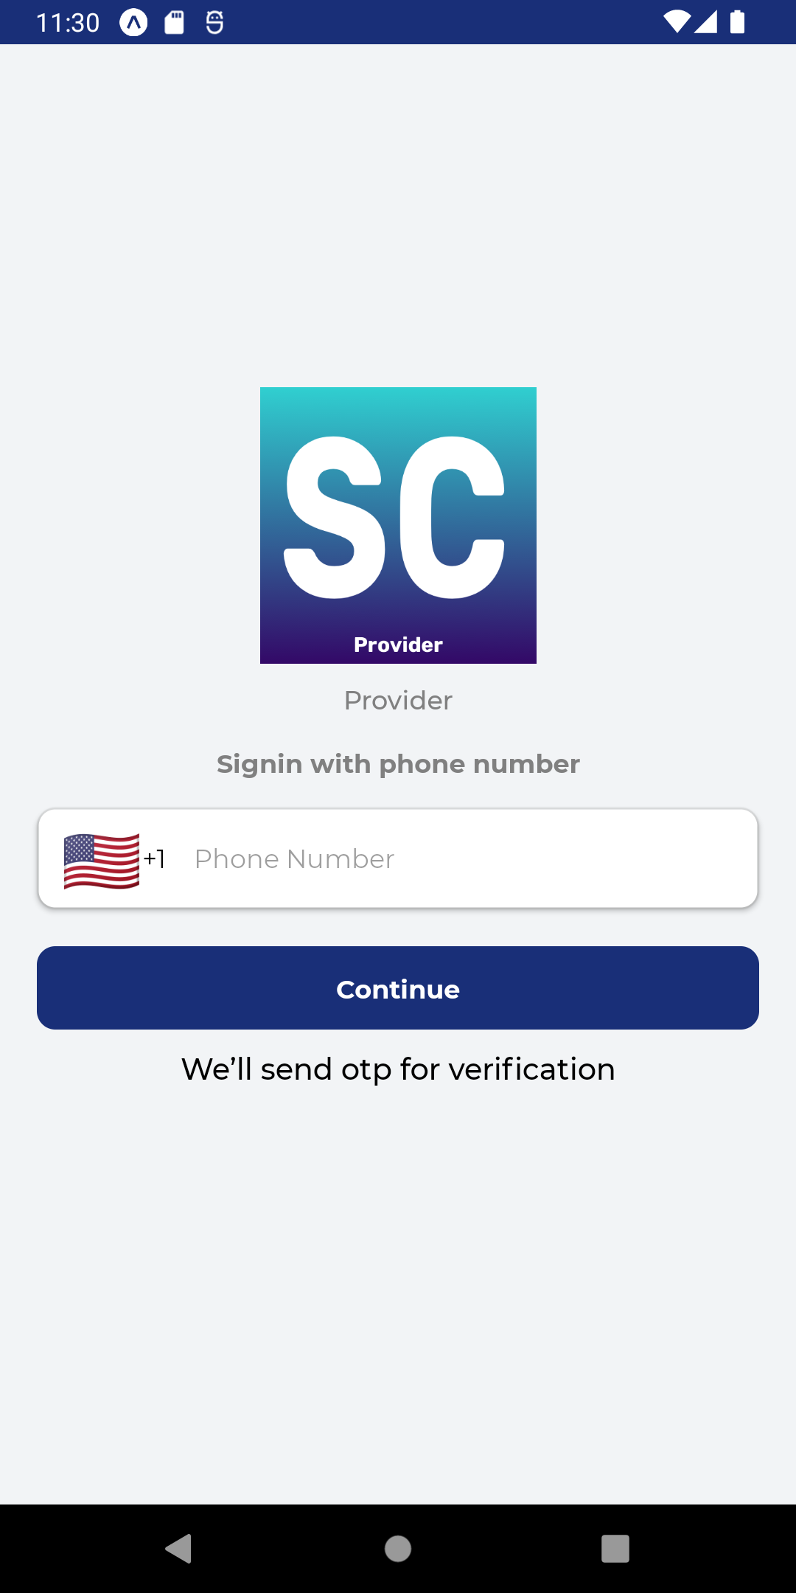
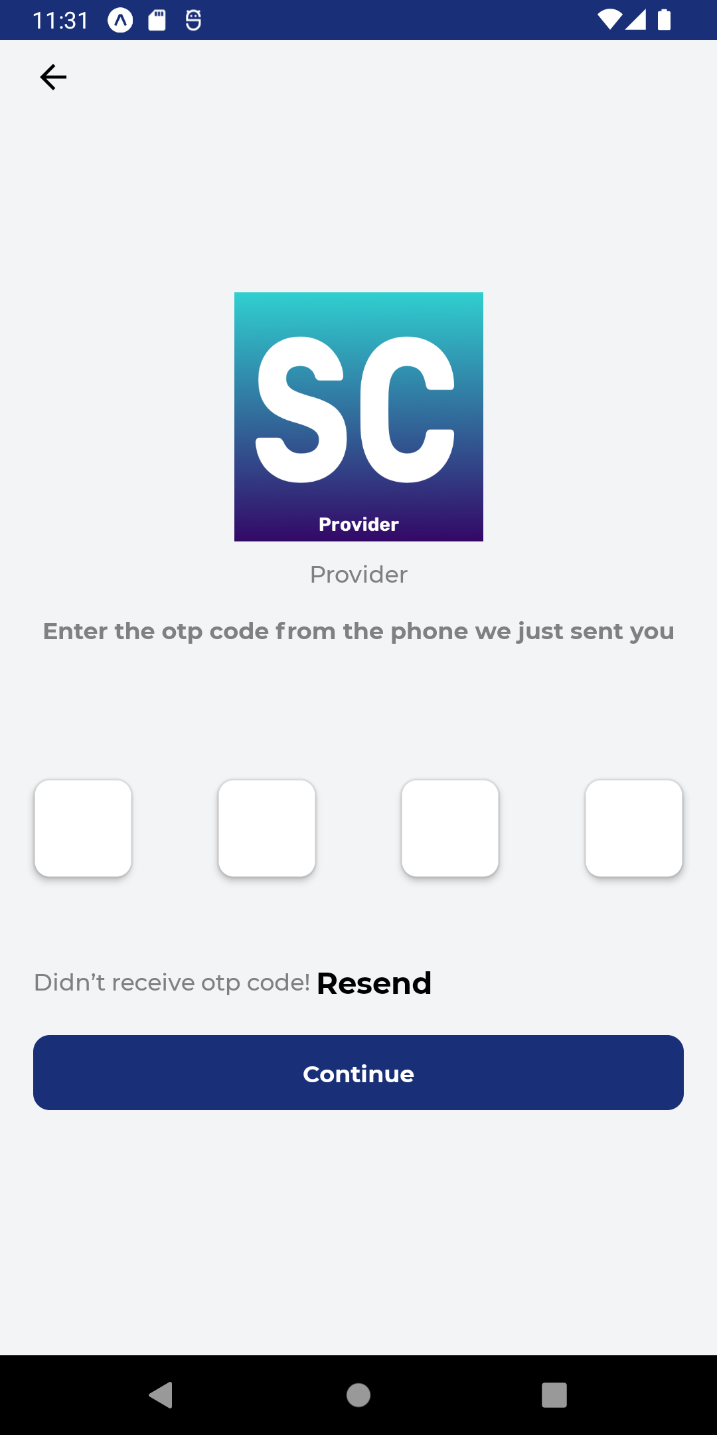

Slide 22
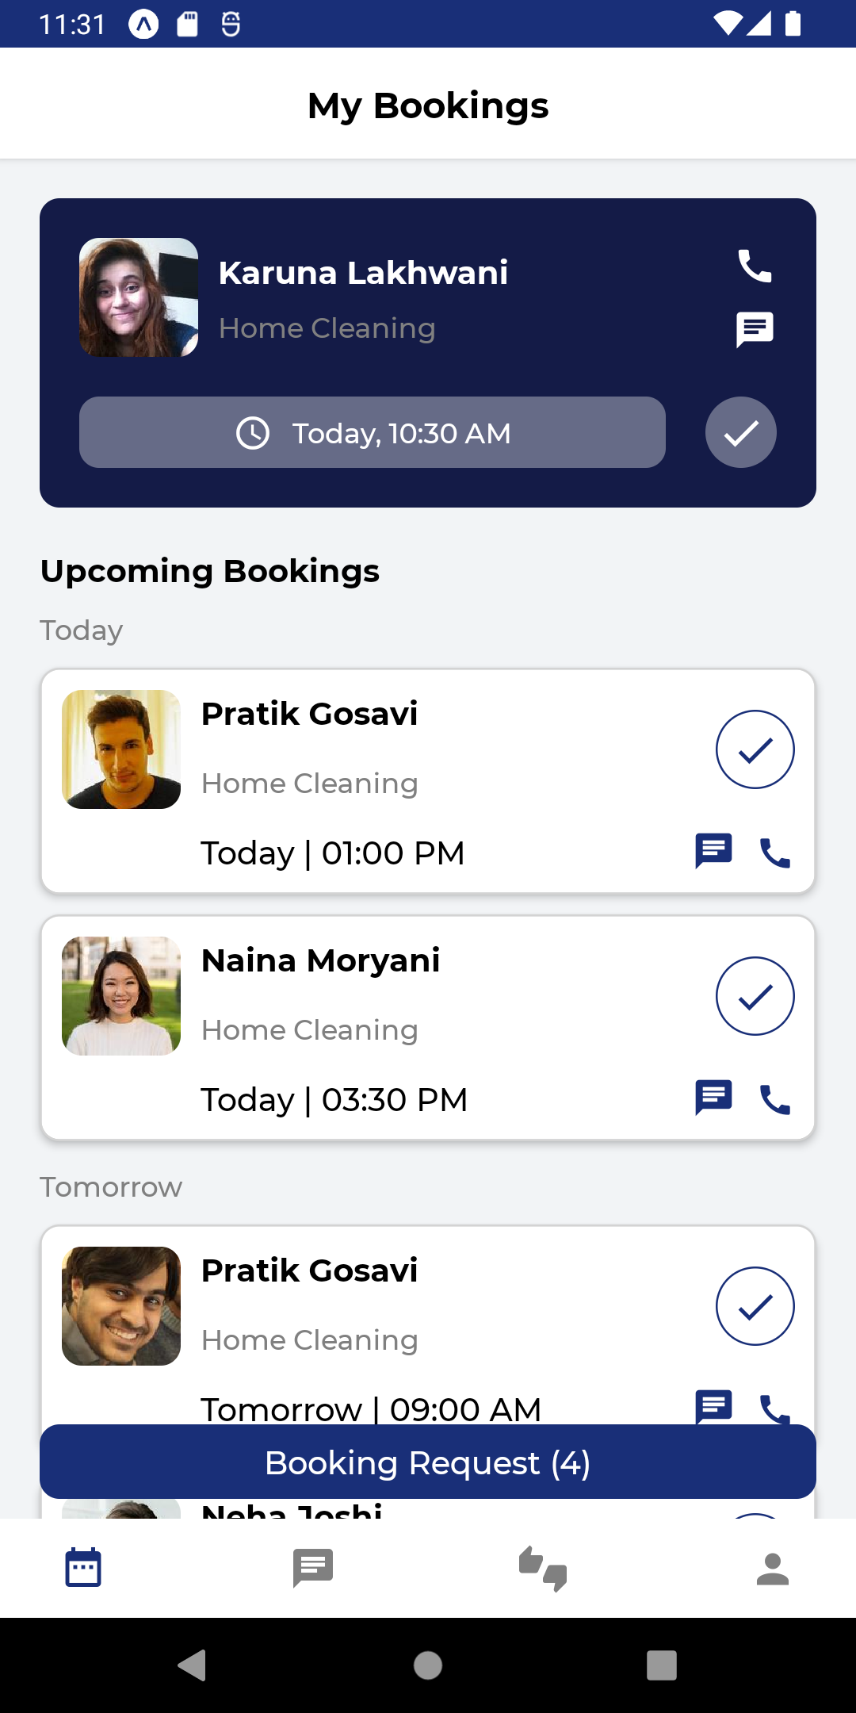
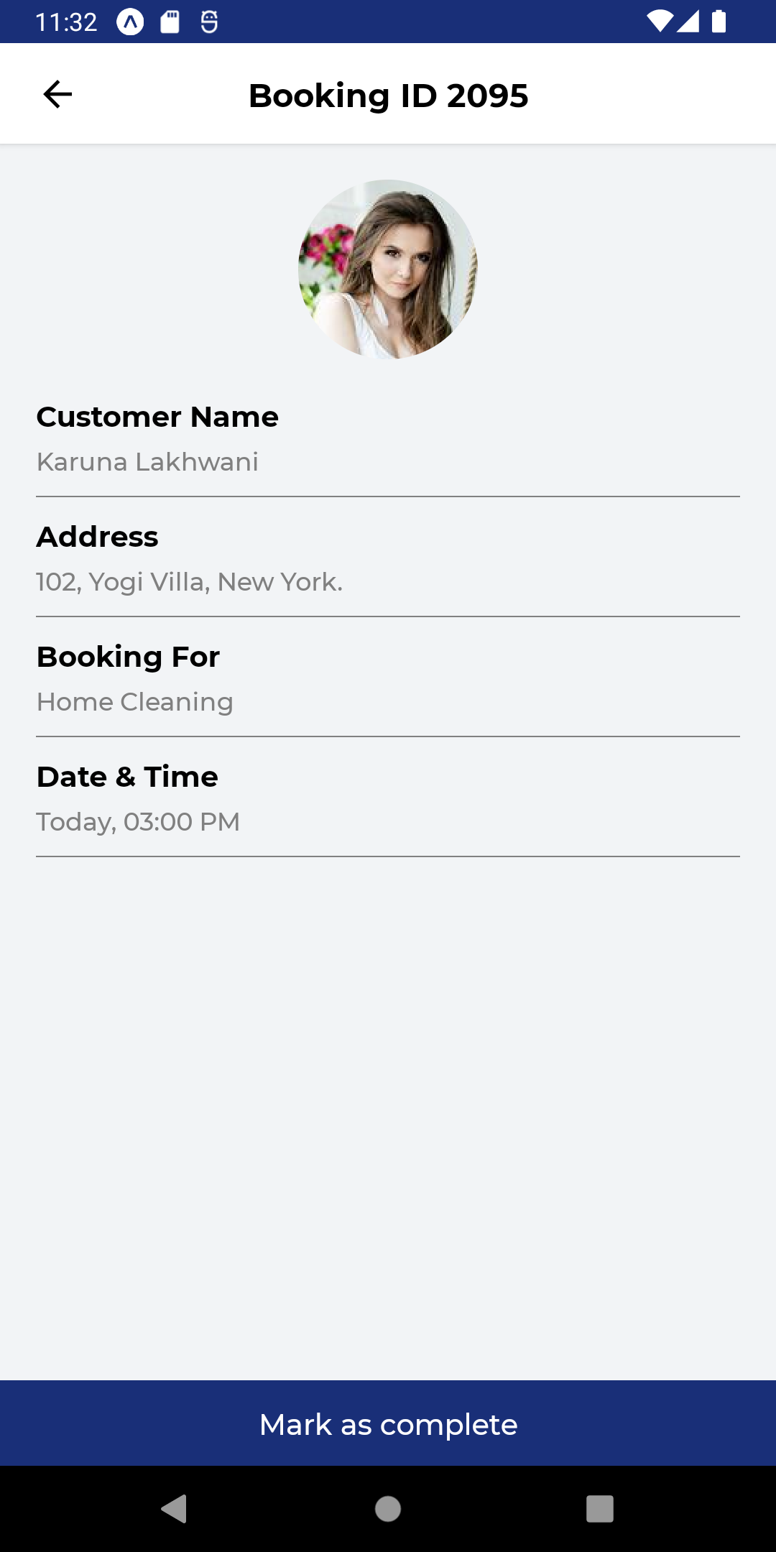
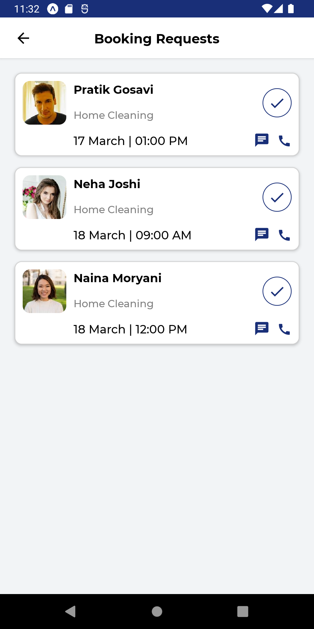

Slide 23
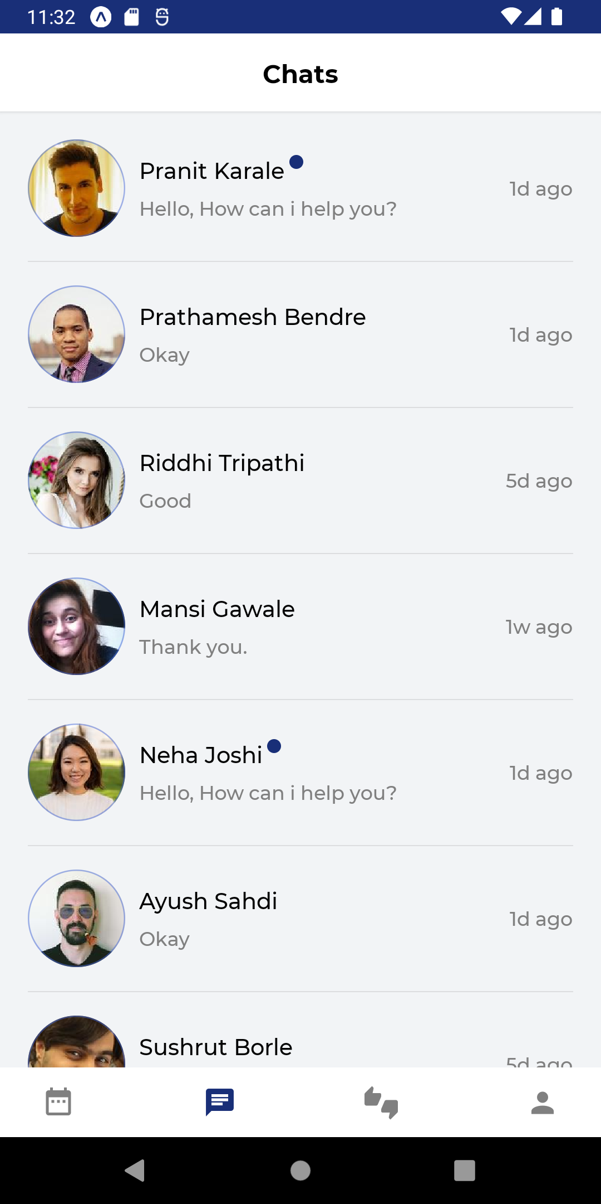

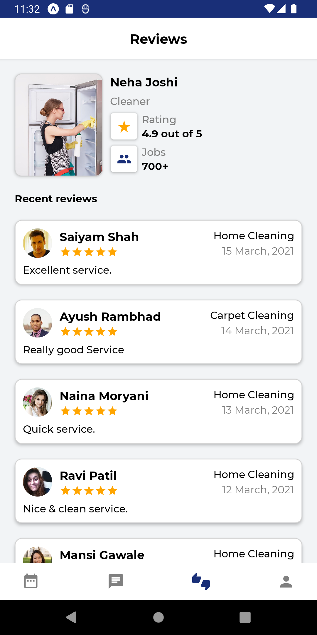

Slide 24
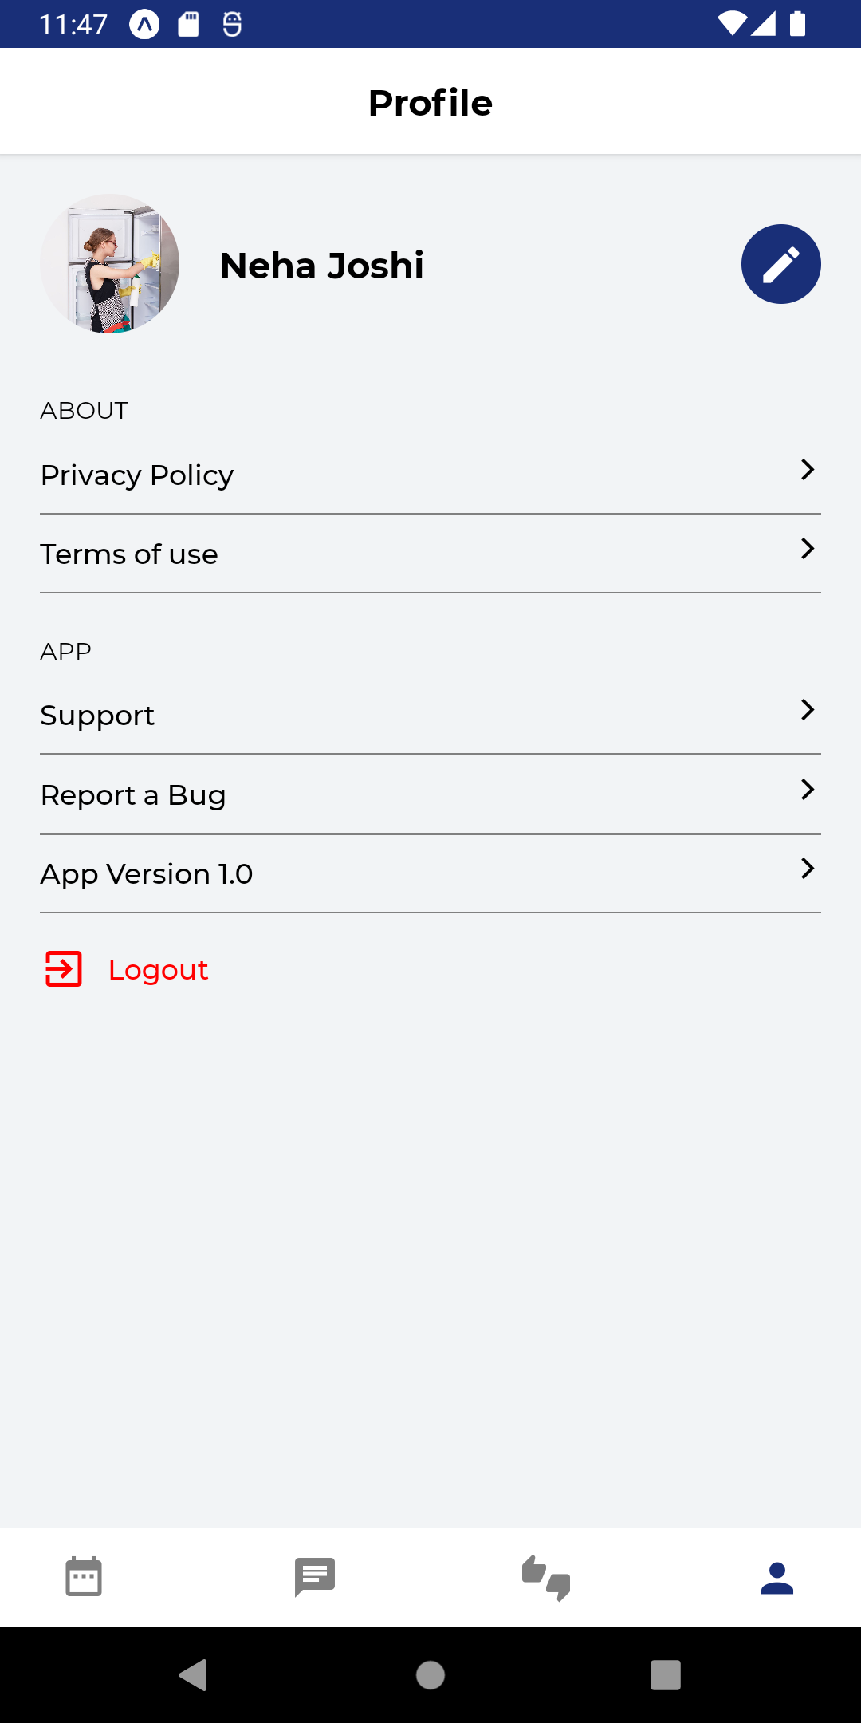
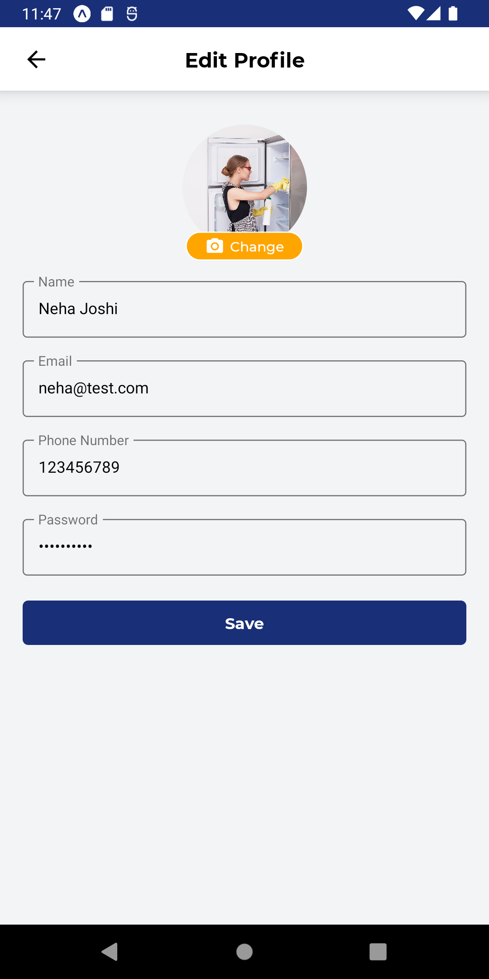
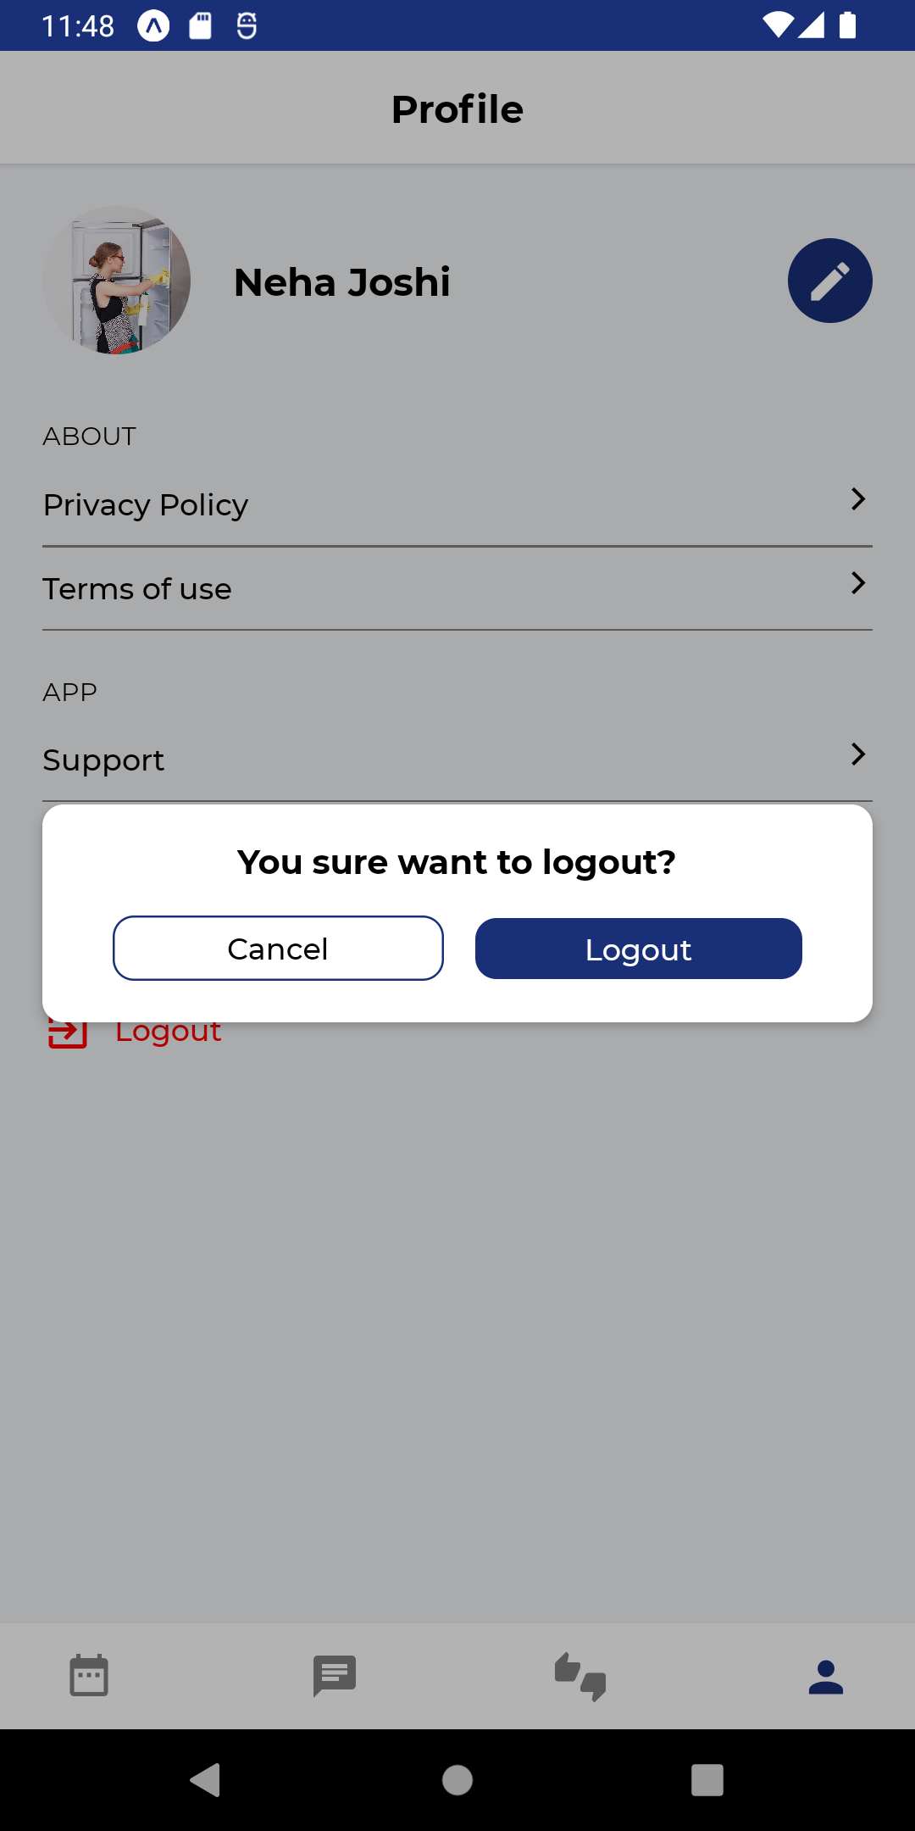

Slide 25
Thank You ☺

